Slide 1









Cruise Ship Data Insights & Market Segmentation

Slide 2



WHY WE’RE HERE?
Identify how Lobster Land Voyage can enter into Luxury cruise market
OUR APPROACH:
Analyze industry leaders to assess performance standards and gaps
Segment Ports: Cluster ports based on traffic, amenities, and strategic value
Optimize Offerings: Tailor cruise experiences to match market demand and customer preferences
Model Risks: Identify and simulate financial, operational, and geopolitical risks

Slide 3

DATA VISUALIZATION
A Tableau dashboard was developed to work with a dataset containing specifications for cruise ships across major cruise lines. The data includes details such as ship age, size, passenger capacity, crew numbers, and passenger density, helping to uncover key trends and operational insights in the cruise industry.

Slide 4
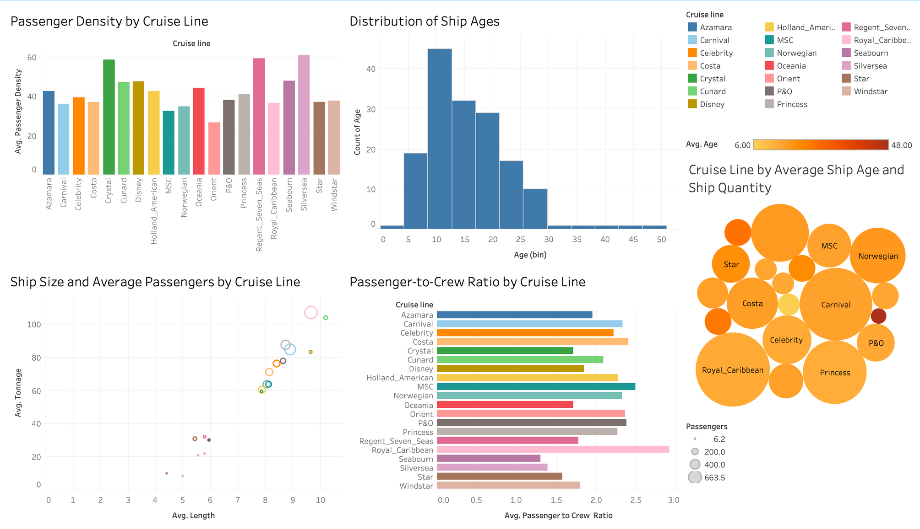

Slide 5

SUMMARY STATS
Caribbean Ports Dataset
The dataset analyzed contains detailed information about Caribbean cruise ports, including metrics such as the average annual number of visitors, passenger spending at different types of ports (Major, Boutique, Private, Eco/Nature), customer satisfaction scores, and local attractions ratings. It covers ports across various regions like the Southern, Eastern, and Western Caribbean, as well as the Bahamas. The data helps to identify trends in visitor traffic, spending behavior, passenger satisfaction, and the attractiveness of local destinations, offering valuable insights into the cruise tourism landscape.

Slide 6


SUMMARY STATS
Ports in the Southern Caribbean attract the highest average number of annual visitors (over 812,000), followed by the Eastern Caribbean. In contrast, the Bahamas and Western regions receive significantly fewer visitors on average.
Passengers tend to spend the most at Major ports (123.65 USD on average), followed closely by Boutique and Eco/Nature ports. Private ports show the lowest average shore spending at about 93.09 USD per passenger.
Customer satisfaction is highest at Boutique ports across all regions, especially in the Bahamas with an average score of 9.21. Major ports generally receive lower satisfaction scores compared to Boutique and Private ports.

Slide 7
SUMMARY STATS
Honduras stands out with the highest average customer satisfaction score (9.96), followed by Mexico, the British Virgin Islands, Grenada, and the Bahamas, all with scores above 9.5. These ports appear to offer the most positive experiences for cruise passengers.
Progreso in Mexico and Port Antonio in Jamaica stand out with the highest local attractions scores (9.0), followed closely by Half Moon Cay, St. Lucia, and Bimini with scores of 8.0. This suggests these ports offer a broader range of attractions compared to other Caribbean destinations.
British Virgin Islands and Grenada report the highest average customer satisfaction scores, each achieving 9.56, despite not having the highest visitor volumes. In contrast, larger markets such as the Dominican Republic and Venezuela attract significant numbers of visitors but show noticeably lower satisfaction levels.

Slide 8


FORECASTING EARNINGS PER SHARE
We developed linear regression models using diluted EPS data from 2018 to 2024 for Norwegian Cruise Line (NCLH) and Carnival Corporation (CCL) to forecast 2025 earnings. Initially, the models projected a 2025 EPS of 9.37 for NCLH and -3.77 for CCL.
After excluding the pandemic-affected years 2020 and 2021, we refined our models to better reflect normal conditions. The adjusted forecasts showed an EPS of 8.53 for NCLH and -6.65 for CCL, providing more realistic projections based on stable operations.

Slide 9
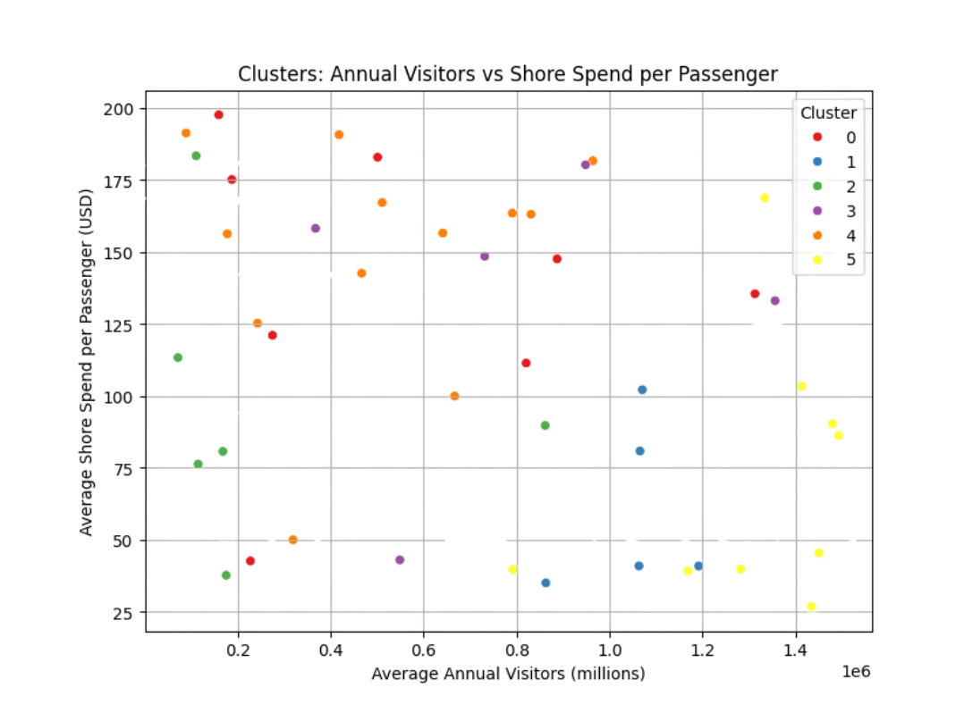
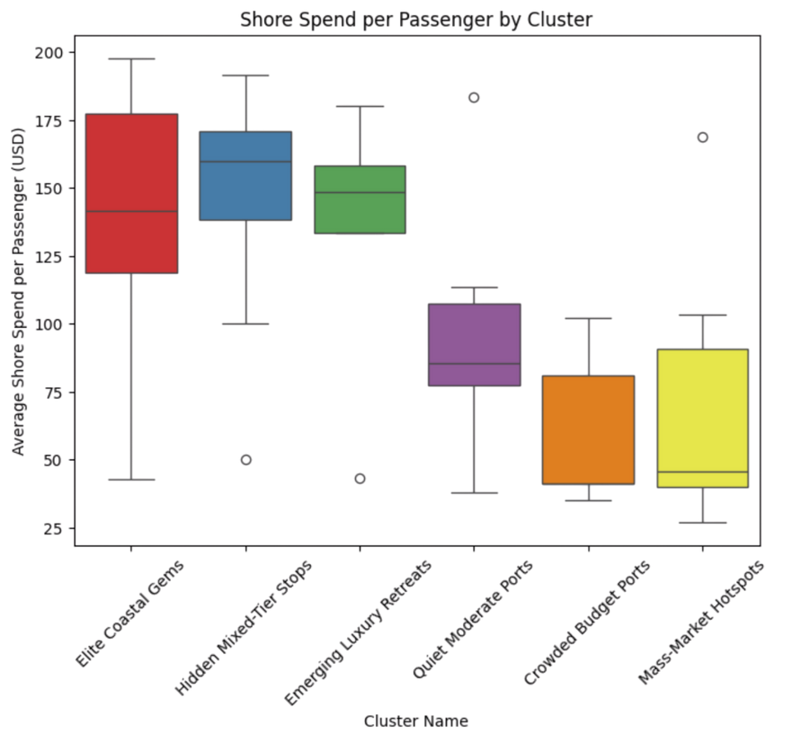

SEGMENTATION & TARGETING
Elite Coastal Gems, Hidden Mixed Tier Stops & Emerging Luxury Retreats - High Spenders with limited visits
Quiet Moderate Ports, Crowded Ports & Mass Market Hotspots-> Low Spenders with high volume visits

Slide 10
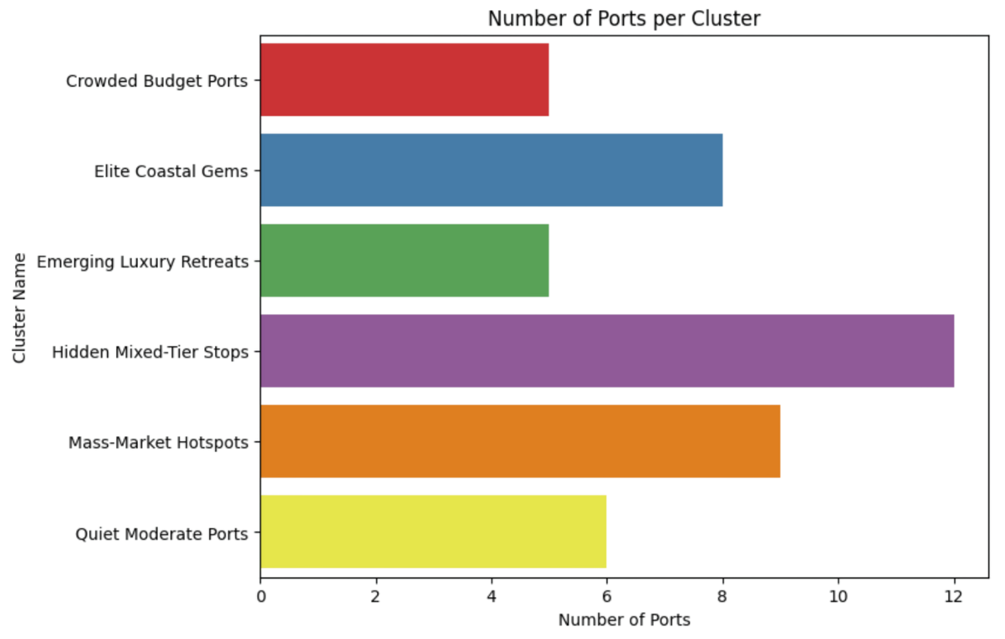
STRATEGIC RECOMMENDATION
Elite Coastal Gems— Pillars of the Voyage
low foot traffic, high passenger spend, and strong alignment with a luxury narrative.
Hidden Mixed-Tier Stops — Can be a Signature destination of Lobster Land Voyage
They’re mysterious, customizable, and positioned perfectly for surprise-and-delight.
Emerging Luxury Retreats - Steady, Scalable, and Smart
offer high spend potential with moderate traffic — a great balance of Return on Investment and customer
Notes:
they’re **mysterious, customizable, and positioned perfectly for surprise-and-delight**.*
We can use these to smooth cost curves while still delivering a **premium feel.**

Slide 11


CONJOINT ANALYSIS

Slide 12
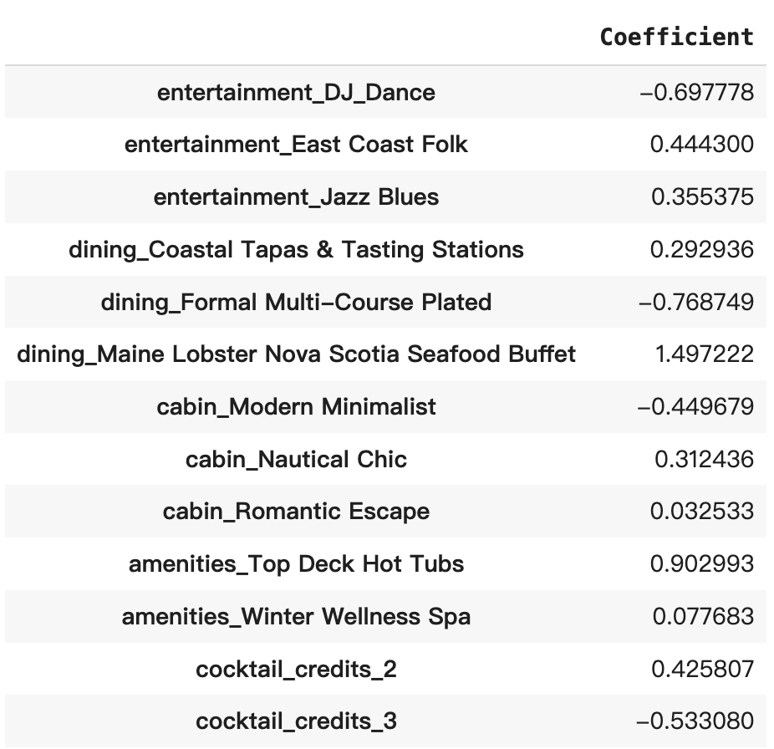


Entertainment: East Coast Folk
Dining: Maine Lobster Nova Scotia Seafood Buffet
Cabin: Nautical Chic
Amenities: Top Deck Hot Tubs
Cocktail Credits: 2 credits
$85.5 > $75

Slide 13
Best Combo
points in rating
↓0.444
cost
↓$13
Entertainment: Acoustic Showcase
Dining: Maine Lobster Nova Scotia Seafood Buffet
Cabin: Nautical Chic
Amenities: Top Deck Hot Tubs
Cocktail Credits: 2 credits
$72.5 < $75

Slide 14

INSIGHTS FROM THE CONJOINT ANALYSIS
Highlight What Customers Love
Lobster Buffet is highly preferred
→ Emphasize it in product design and promotions
Improve or Phase Out Low-Rated Options
Items like Formal Multi-Course Dinner
→ Consider improving or removing
Enable Flexible Customization
Adjust based on traveler groups (e.g., families, couples)
Tailor to cruise themes (e.g., holiday, romantic)
→ Goal: Improve overall satisfaction

Slide 15
UNDERSTANDING CRUISE CANCELLATIONS
To identify key factors that influence cruise booking cancellations and provide actionable marketing insights, we built a logistic regression model for classification.

Slide 16
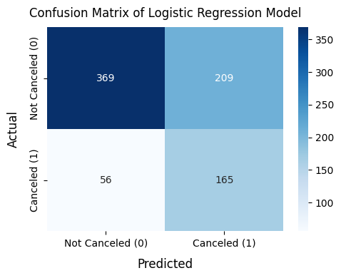
WHAT DRIVES CANCELLATIONS?
booking late
making partial payments
having lower loyalty status
booking interior cabins
having lower income levels
Accuracy Rate: 67%.
Sensitivity Rate: 75%
Balanced Accuracy: 60%

Slide 17
WHAT CAN MARKETING DO?
Proactive Outreach:
Reach out early
Offer discounts or reminders for partial payers
Loyalty Program Enhancements:
Upgrade incentives for Silver members
Outreach to non-members highlighting benefits
Targeted Promotions:
Perks for Interior cabin bookers (e.g. upgrades, discounts)
Reinforce premium experience for Balcony/Oceanview customers
Segmented Messaging by Income:
Flexible payment plans for price-sensitive groups
Premium packages for higher-income customers

Slide 18



LOBSTER LAND CRUISE CAMPAIGN A/B TEST

Slide 19
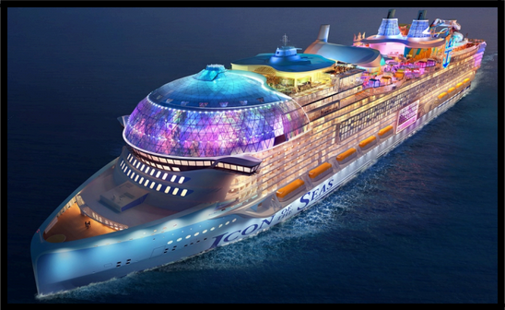
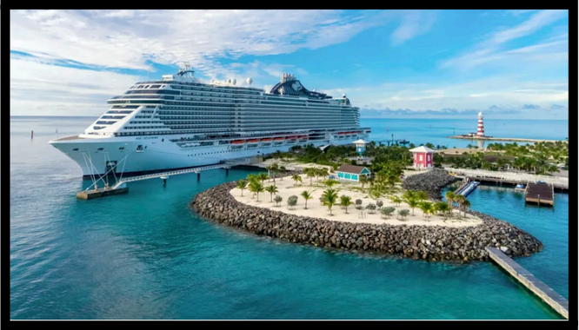
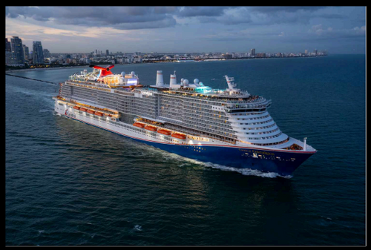
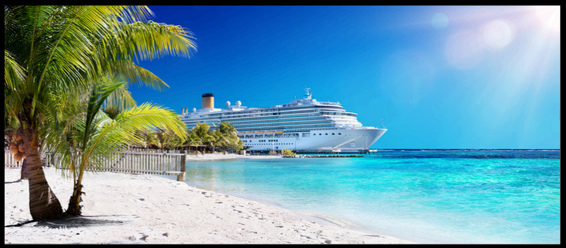
A/B TEST & KEY INSIGHTS
Night Glow: Excellent at converting clicks into info session bookings (12.7%)
Caribbean Port: Highest CTR (26.7%) but low engagement beyond the click
City Visit: Struggled across all metrics, with the lowest CTR (8.6%) and ratings (6.2/10)
Tropical Beach: 16.5% CTR, the highest rating (8.1/10), and strong conversion rates (9.7% info session bookings)
Key Metrics: CTR, info session bookings, email share rates, photo save rates, time-on-page, follow-up clicks

Slide 20


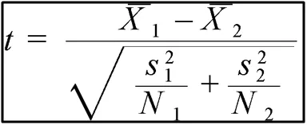
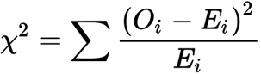

Test | Statistic | p-value | Interpretation
Chi-Square Test for CTR | 37.9955 | 2.83 × 10⁻⁸ | Statistically significant difference in CTR; photo affects user engagement.
Chi-Square Test for Info Session Bookings | 12.9596 | 4.72 × 10⁻³ | Statistically significant difference in bookings; photo influences conversions.
Chi-Square Test for Email Share Rates | 7.6910 | 5.29 × 10⁻² | No significant difference in email shares; differences likely due to random chance.
Chi-Square Test for Photo Save Rates | 3.7766 | 2.87 × 10⁻¹ | No significant difference in photo saves; differences likely due to random chance.
ANOVA for Time on Page | 2.025 | 0.109 | No significant difference in time spent on page across photos.
ANOVA for Follow-up Clicks | 0.506 | 0.678 | No significant difference in follow-up clicks across photos.
STATISTICAL TEST RESULTS

Slide 21

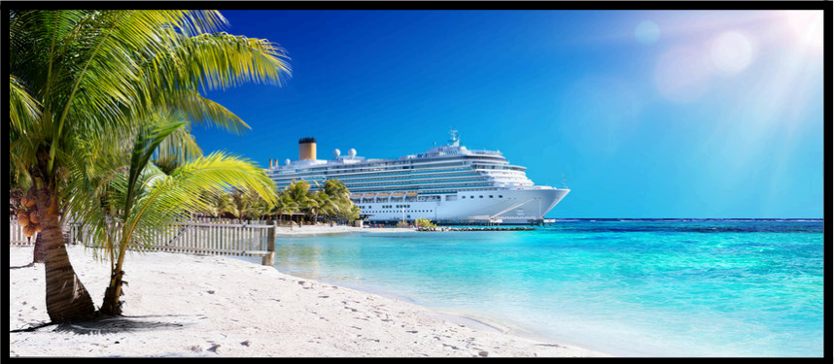
TROPICAL BEACH
FINAL RECOMMENDATION
It combines high CTR, strong user ratings, and good conversion rates.
Other photos had strengths but failed to convert engagement into measurable actions.

Slide 22


CASE STUDY
ICON OF THE SEAS - THE LARGEST CRUISE LINER IN THE WORLD.
ICON OF THE SEAS
Royal
Caribbean
*ALL LOGOS AND TRADEMARKS REMAIN THE PROPERTY OF THEIR RESPECTIVE OWNERS.

Slide 23
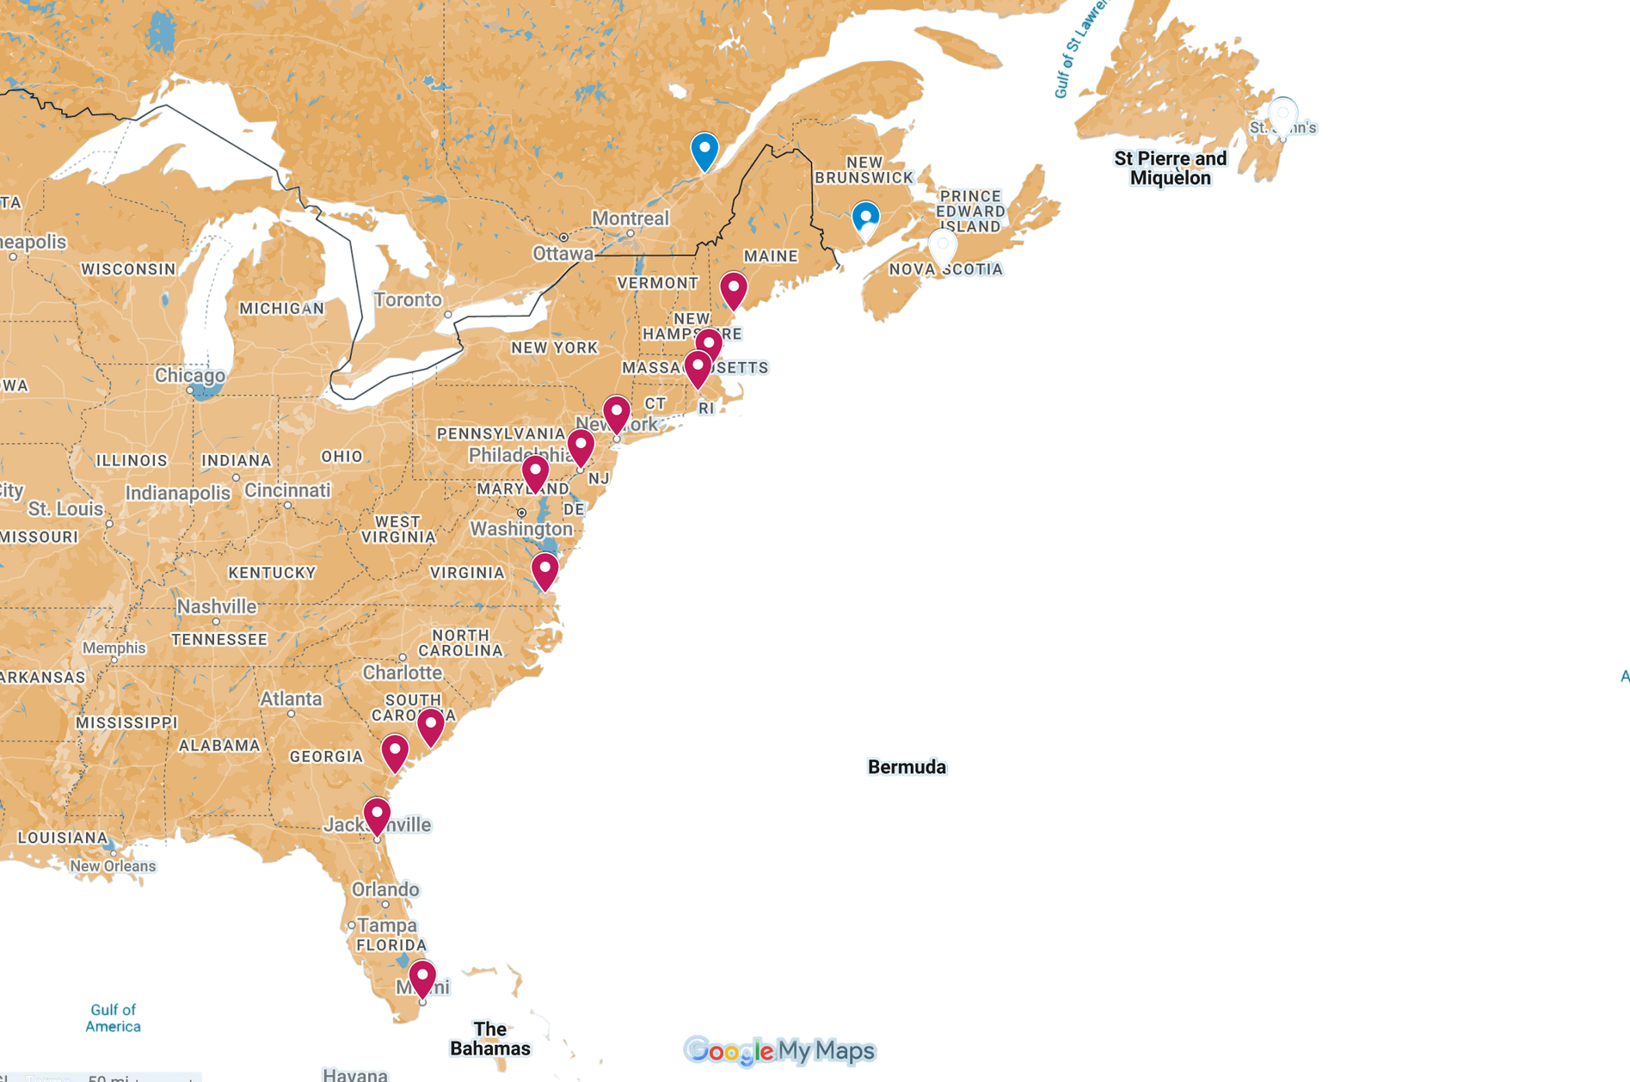
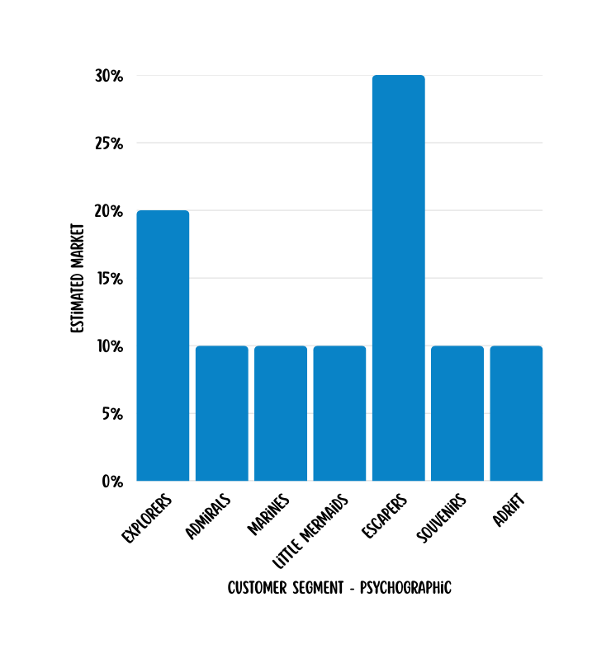
North
Atlantic
Ocean

Slide 24



EXPLORERS
SOUVENIRS
LITTLE MERMAIDS
Affluent, frequent travelers, cultural learning, social connections, align with Lobster Land’s Atlantic ports.
Underserved, price-sensitive, drawn to deals, focus on the moment, attracted by value-driven offerings.
Upper-middle-class families, quality bonding, family-focused leisure, value good children’s activities.

Slide 25
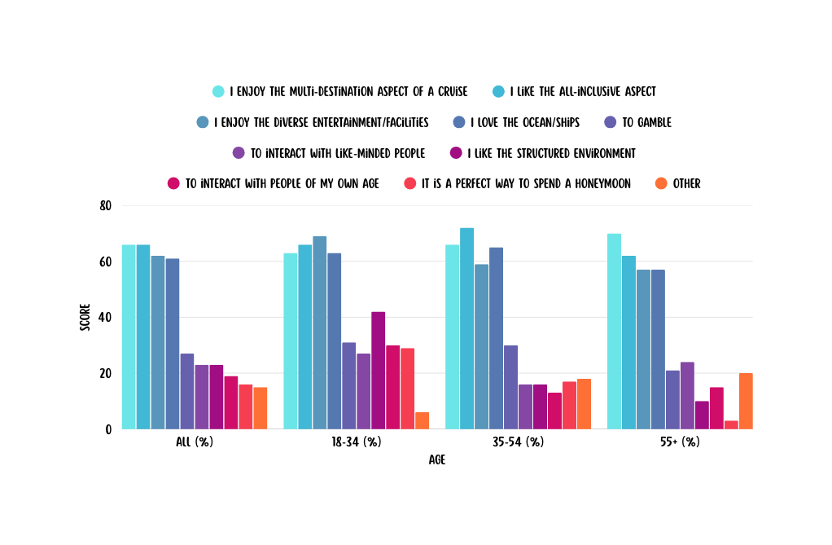
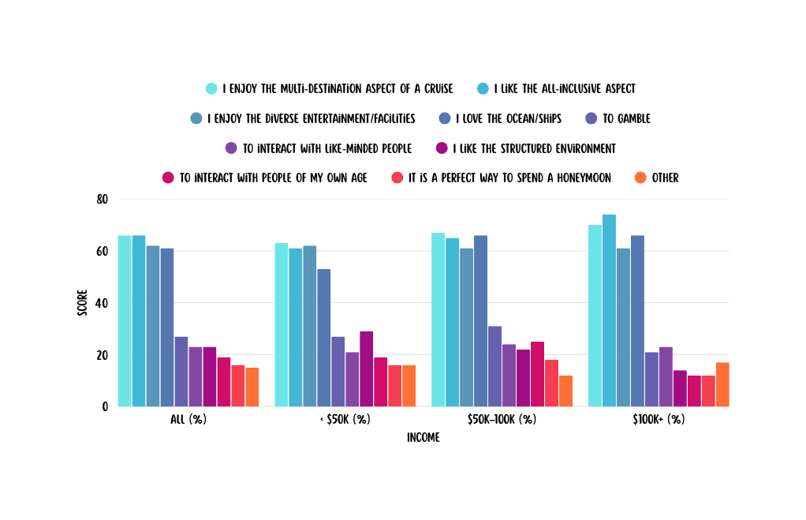
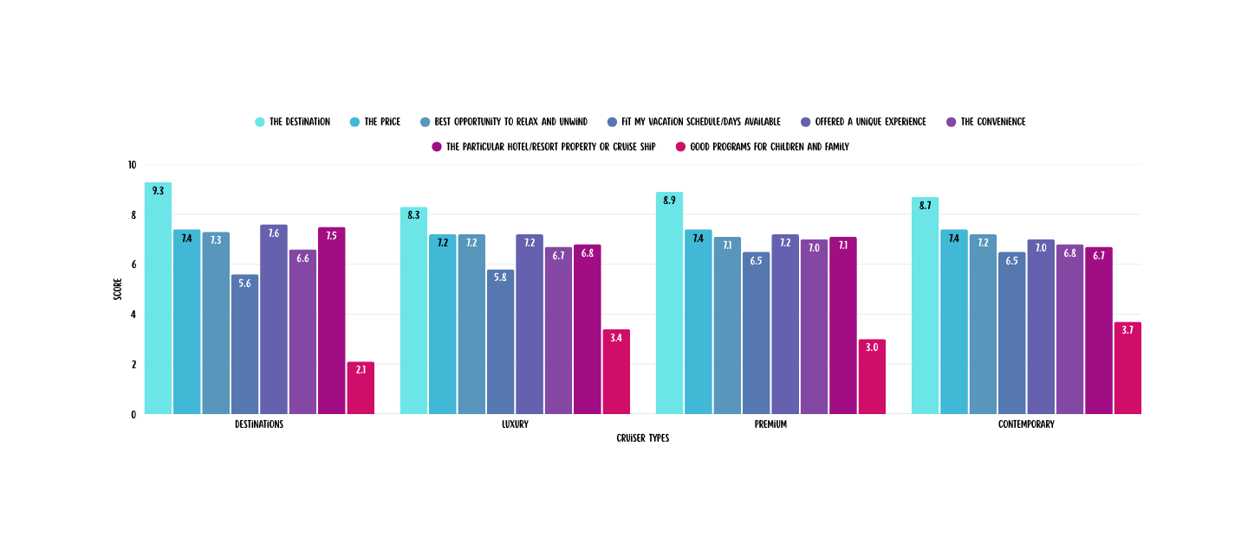
ATTRIBUTES INFLUENCED LAST VACATION

Slide 26



EXPLORERS-MARITIME CULTURE LAB
SOUVENIRS - COASTAL VALUE DINING PASS
LITTLE MERMAIDS-
LOBSTER FEST FAMILY DECK
Workshops on lobster fishing, folklore storytelling, crafting mini traps, inspired by Icon’s Central Park.
All-inclusive dining, daily lobster meals, budget-friendly, inspired by Icon’s affordable pool offerings.
Lobster-themed obstacle course, splash zone, picnic with games, modeled after Icon’s entertainment zone.

Slide 27


(For Explorers)
Blends cultural learning with social engagement
Evokes Atlantic maritime folklore storytelling
Reinforces Lobster Land’s authentic heritage
“LOBSTER TALES WORKSHOP”
Challenge & Trade-off
Balancing space & budget across segments.
Flexible multi-use spaces (e.g., Maritime Culture Lab → dining area)
Optional paid shore excursions to maintain affordability

Slide 28
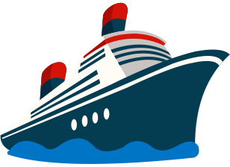
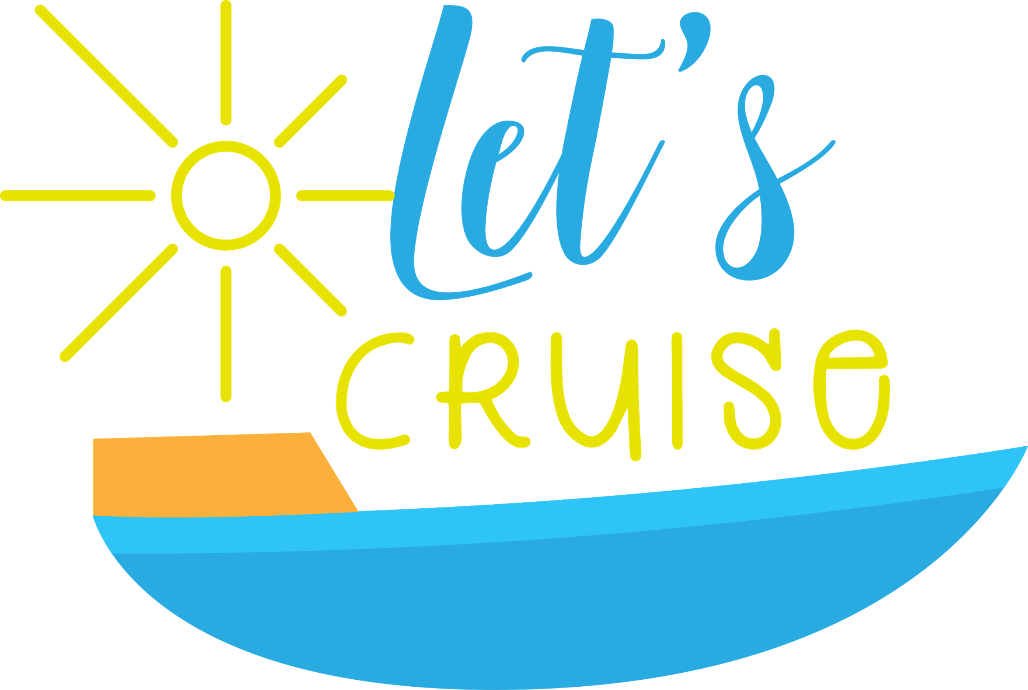
CONCLUSION

